Slide 1
Corporate Presentation
April 2 025
© 2022 mdxhealth. All rights reserved | 1

Slide 2
Forward looking statement
This presentation contains forward-looking statements and estimates with respect to the anticipated future performance of mdxhealth and the market in which it operates. These statements are often, but are not always, made through the use of words or phrases such as “potential,” “expect,” “will,” “goal,” “next,” “potential,” “aim,” “explore,” “forward,” “future,” and “believes” as well as similar expressions. Forward-looking statements contained in this presentation include, but are not limited to, statements regarding the acquisition of Oncotype DX® GPS prostate cancer business from Exact Sciences including statements regarding the anticipated benefits of the acquisition; statements regarding expected future operating results; statements regarding product development efforts; and statements regarding our strategies, positioning, resources, capabilities and expectations for future events or performance. Such statements and estimates are based on assumptions and assessments of known and unknown risks, uncertainties and other factors, which were deemed reasonable but may not prove to be correct. Actual events are difficult to predict, may depend upon factors that are beyond the company’s control, and may turn out to be materially different. Examples of forward-looking statements include, among others, statements we make regarding expected future operating results; product development efforts, our strategies, positioning, resources, capabilities and expectations for future events or performance. Important factors that could cause actual results, conditions and events to differ materially from those indicated in the forward-looking statements include, among others, the following: uncertainties associated with global macroeconomic conditions; our ability to successfully and profitably market our products; the acceptance and reimbursement of our products and services by healthcare providers and payors; our ability to obtain and maintain regulatory approvals and comply with applicable regulations; the possibility that the anticipated benefits from our business acquisitions like our acquisition of the Oncotype DX® GPS prostate cancer business will not be realized in full or at all or may take longer to realize than expected; and the amount and nature of competition for our products and services. Other important risks and uncertainties are described in the Risk Factors sections of our most recent Annual Report on Form 20-F and in our other reports filed with the Securities and Exchange Commission. The Company expressly disclaims any obligation to update any such forward-looking statements in this presentation to reflect any change in its expectations with regard thereto or any change in events, conditions or circumstances on which any such statement is based unless required by law or regulation. The Company obtained the industry, statistical and market data, including its general expectations, market position and market opportunity, in this presentation from its own internal estimates and research as well as from industry and general publications and research, surveys and studies conducted by third parties. The market data used in this presentation involves a number of assumptions and limitations. While the Company believes that the information from these industry publications, surveys and studies is reliable, the industry in which it operates is subject to a high degree of uncertainty and risk due to a variety of important factors. These and other factors could cause results to differ materially from those expressed in the estimates made by third parties and by the Company. This presentation does not constitute an offer or invitation for the sale or purchase of securities or assets of mdxhealth in any jurisdiction. No securities of mdxhealth may be offered or sold within the United States without registration under the U.S. Securities Act of 1933, as amended, or in compliance with an exemption therefrom, and in accordance with any applicable U.S. securities laws.
Analyst Coverage
Any opinions, estimates or forecasts made by analysts are theirs alone and do not represent opinions, forecasts or predictions of mdxhealth or its management. Requests for copies of analyst reports should be directed at the respective analyst and institution.
NOTE: The mdxhealth logo, mdxhealth, Confirm mdx, Select mdx, Resolve mdx, Genomic Prostate Score, GPS and Monitor mdx are trademarks or registered trademarks of MDxHealth SA. All other trademarks and service marks are the property of their respective owners. The GPS test was formerly known as and is frequently referenced in guidelines, coverage policies, reimbursement decisions, manuscripts and other literature as Oncotype DX Prostate, Oncotype DX GPS, Oncotype DX Genomic Prostate Score, and Oncotype Dx Prostate Cancer Assay, among others. The Oncotype DX trademark, and all other trademarks and service marks, are the property of their respective owners.

Slide 3
mdxhealth provides highly accurate and clinically actionable urologic solutions to inform patient diagnosis and treatment
while improving healthcare economics for
payers and providers
Ticker: MDXH

Slide 4
mdxhealth fundamentals for growth
Fundamentals in place
Levers for growth
Compelling and comprehensive menu in prostate cancer
Robust clinical data
Established reimbursement and guidelines inclusion
Expansion of mdxhealth clinical pathway for prostate cancer
(acquisition of Genomic Prostate Score)
Expanding coverage of current menu (Select mdx LCD published)
Expanding US commercial footprint
Established focus & execution
Potential opportunities
World-class CLIA certified multi-state lab operations
Experienced and expanded channel into urology
Urinary Tract Infection opportunity validated
Opportunistic decentralization of menu as appropriate
Expanded channel outside of urology
Menu Expansion: Monitor mdx and business development opportunities

Slide 5
Experienced leadership team
Track record of success
Michael K. McGarrity
Chief Executive Officer
Ron Kalfus
Chief Financial Officer
John Bellano
Chief Commercial Officer
Joseph Sollee
Executive Vice President Corp. Dev. General Counsel
Joined mdxhealth in 2008 Triangle Pharmaceuticals TherapyEdge
Miriam Reyes
Executive Vice President
Laboratory Operations
Joined Mdxhealth in 2011
CombiMatrix Agendia Labcorp
Joined mdxhealth in 2019 Nanosphere (Luminex/DiaSornin) Stryker
Joined mdxhealth in 2019 Rosetta Genomics Mabcure
Joined mdxhealth in 2019 Assurex Health (Myriad Genetics) Third Wave Technologies (Hologic) Roche Diagnostics Molecular Diagnostics

Slide 6
Our menu addresses a $4.9B U.S. market opportunity ⁽¹⁻⁵⁾
Comprehensive Urology Menu
5
$1B $4.9B
$1.5B
4
3
$450M
$450M
2
$1.5B
1
GPS
Monitor mdx*
Total
*In development

Slide 7
Commercial levers to drive growth
One of the most compelling, comprehensive and accurate menus in urology
Standardized laboratory partner for urology group practice
One rep
One laboratory
One patient support program
ONE PARTNER in the diagnosis and treatment of prostate cancer
Acquired August 2022
Acquired Exact Sciences’ Genomic Prostate Score (GPS) test
Established brand with broad customer base
Covered by Medicare
Validated advanced Urinary Tract Infection (UTI) opportunity
Launched in second half of 2021
Experienced distribution channel and broad KOL network
Expanded commercial team to >70 people
UTI test launched 2021

Slide 8
Current challenges with diagnosing prostate cancer
Prostate cancer is the most common cancer and the 2nd deadliest cancer in U.S. men ⁽¹⁾
Prostate cancer screening
~3 million elevated PSA results annually ⁽¹⁻²⁾
60%
~60% of biopsies DO NOT reveal cancer and may lead to increased complications and hospitalization ⁽³⁻⁶⁾
Prostate cancer diagnosis
~ 500,000 men undergo biopsies annually ⁽²⁾
30%
~30% of cancer-negative biopsies are false negatives,
meaning these patients actually have cancer ⁽⁷⁾
Prostate cancer risk stratification
~300,000 prostate cancers diagnosed annually ⁽⁸⁾
69%
~69% of new prostate cancer diagnosis are localized; Active Surveillance or treatment decision⁽⁸⁾
CONFIDENTIAL
© 2024 mdxhealth. All rights reserved© 2024 mdxhealth. All rights reserved || 88

Slide 9
Expanding menu in the prostate cancer diagnostic pathway
One of the most comprehensive menus in prostate cancer
Screening Patient Selection Diagnosis Active Surveillance Intervention
Cancer-negative
Biopsy
Biopsy/MRI
PCa screening (PSA test)
Localized Prostate Cancer
Active Surveillance
Biopsy
Monitor mdx*
Regional/Mets Prostate Cancer
Intervention
Hereditary Prostate Cancer Test
*in development
© 2024 mdxhealth. All rights reserved | 9
© 2024 mdxhealth. All rights reserved | 9

Slide 10
improves patient selection prior to prostate biopsy
Non-invasive: Urine-based “rule-out” test improves the diagnostic disposition of patients by avoiding unnecessary prostate biopsies
Accurate: 95% negative predictive value ⁽¹⁾
Validated: 12 published studies on genes and
A highly predictive test to identify men at low risk for aggressive prostate cancer
technology
Cost effective: Potential to avoid invasive and unnecessary prostate biopsies and save the U.S. healthcare system >$500 million ⁽²⁾ each year
National guidelines: Included in EAU and NCCN
Abnormal PSA/DRE
At risk for aggressive cancer?
guidelines ⁽³⁻⁴⁾
95% NPV
Binary actionable results for patient and HCP
60% of initial biopsies do not reveal cancer ⁽⁵⁻⁸⁾
Positive
Biopsy
60%
Negative
Routinely Monitor
ghts reserved | 10

Slide 11
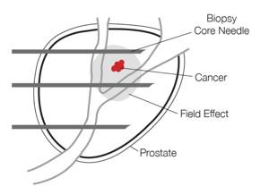
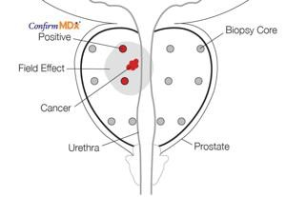
improves diagnostic confidence of biopsy result
Non-invasive: “Rule-out” test performed on
previous biopsy tissue
The only epigenetic test to identify men at risk for aggressive prostate cancer
Accurate: 96% Negative Predictive Value for
aggressive prostate cancer ⁽¹⁾
Validated: Over 55 published studies on genes
and technology
False-negative biopsy
96% NPV ⁽¹⁾
Cost effective: Potential annual U.S. health system savings of $500K per 1M covered
patients ⁽²⁾
National guidelines: Included in EAU and
NCCN guidelines ⁽³⁻⁴⁾
30% of men with a cancer-negative biopsy result actually have
30%
cancer ⁽⁵⁾
Positive
Biopsy/MRI
Negative
Avoid
Biopsy/MRI
ghts reserved | 11

Slide 12
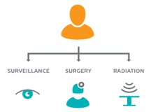
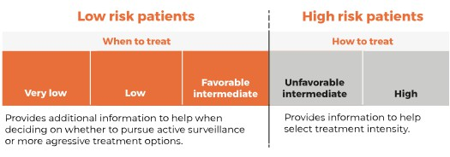
Genomic Prostate Score (GPS) guides treatment decisions for localized prostate cancer
The test analyzes prostate cancer gene activity to predict disease aggressiveness and provide clinically meaningful endpoints ⁽¹⁻²³⁾
Non-invasive: test performed on previous biopsy tissue
Accurate: Predicts adverse pathology, distant metastasis, prostate cancer mortality and pT3/Extra prostatic extension
Validated: Predicts adverse pathology in AS candidate cohorts in 7 studies >2,000 patients
How the test
can help you
Low Risk
Active
Surveillance
High Risk
Treatment
Intensity

Slide 13
Hereditary Prostate Cancer Testing
Hereditary prostate
cancer accounts for
5-10%
of newly diagnosed patients
Prostate cancer remains a leading cause of cancer-related death among men, with an estimated 300,000 new diagnoses and 35,000 deaths annually. Decades of research indicate that prostate cancer has a strong genetic component with implications to ancestry.
Prostate cancer has the highest heritability of any major cancer in men
Hereditary Prostate Cancer Testing:
is recommended in the National Comprehensive Cancer Network (NCCN) guidelines
is critical to identify patients eligible for novel therapies (e.g., PARP inhibitors, immunotherapies, and targeted agents for inherited prostate cancers)
is covered by Medicare and many commercial insurance plans, for eligible patients
© 2©02₂4 m₂₂dx_{m}h_{d}e_{x}a_{h}lt_{e}h. _{l}A_{th}ll. r_{A}ig_{ll}h_{r}t_{i}s_{gh}re_{ts}se_{re}rv_{se}d_{rv d}| 1| 3

Slide 14
Prostate cancer pipeline
Active surveillance monitoring (Localized prostate cancer)
1.5M
Est. market size
(men annually)
Monitor mdx
Patients under active surveillance are currently monitored by invasive and costly prostate biopsies
Monitor mdx will be a non-invasive alternative that risk-stratifies patients for continued active surveillance vs. intervention, which may also improve patient compliance
High risk
Intervention
Monitor mdx*
Low Risk
Continued Active
Surveillance
*In development
© 2024 mdxhealth. All rights reserved | 14
© 2024 mdxhealth. All rights reserved | 14© 2022 Mdxhealth All rights reserved | 14

Slide 15
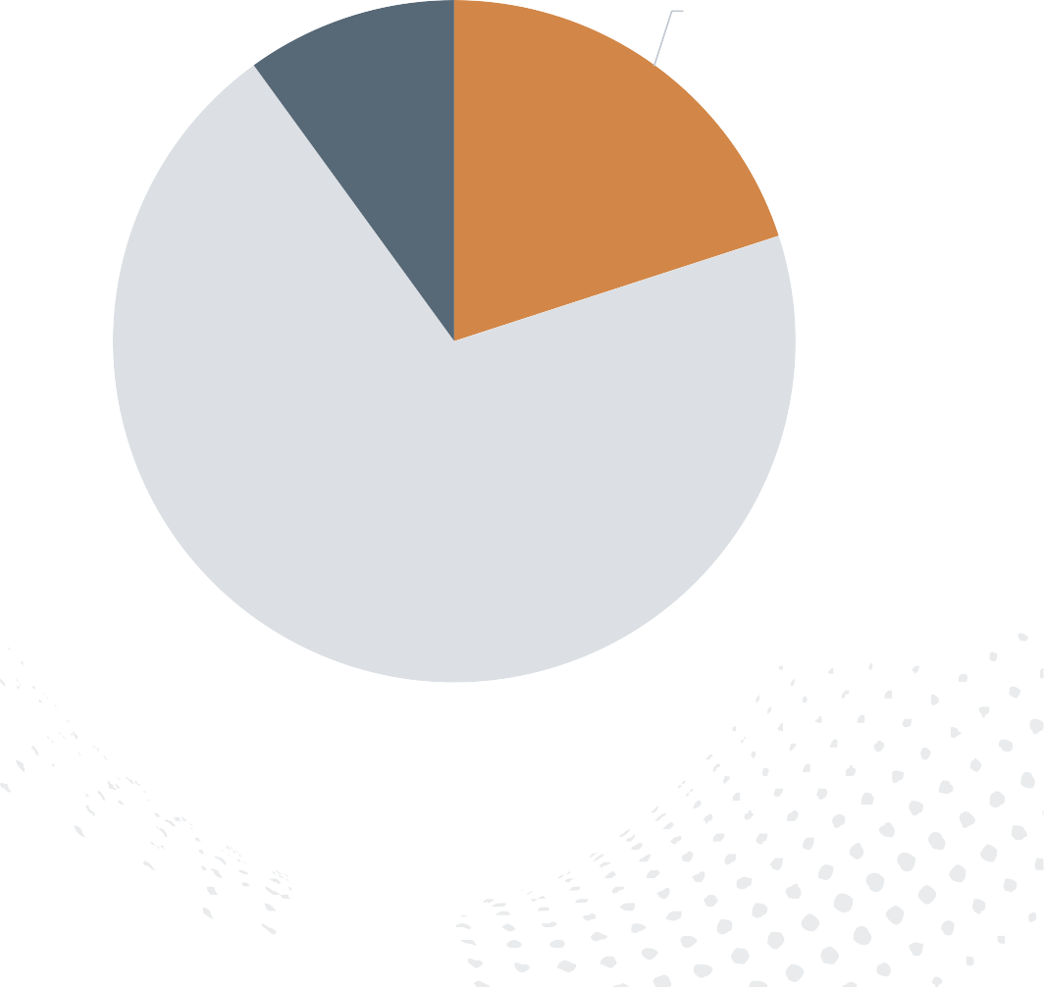
Urinary Tract Infection (UTI) annual market opportunity
UTIs are the most common outpatient infection⁽¹⁾
10 million suspected UTI cases present annually⁽²⁾
20% of volume presents to urology⁽³⁾
Long Term Care 10%
Urology
20%
The current UTI testing market is underserved
Current standard is based on dated culture methodologies
Complex molecular methods target both organism and susceptibility markers
Market conversion comps: Virology and infectious disease
Reimbursement well characterized (Medicare/commercial)
Primary Care 70%
The addressable market for UTI testing in the
urology segment is 2M tests⁽²⁾ annually, or $1B⁽³⁾
U.S. Market for UTI⁽³⁾
© 2024 mdxhealth. All rights reserved | 15

Slide 16
: Advance molecular urinary tract infection testing
Non-invasive: Urine-based test that provides personalized antibiotics options for urinary
As many as 33% of urine cultures are polymicrobial, especially in elderly populations, and traditional urine culture may miss up to 67% of recognized uropathogens
tract infections.
Accurate: 19 pathogens, 6 classes of resistance genes and susceptibility to guide
Resolve mdx identifies and quantities uropathogenic bacteria and associated antibiotics susceptibility
antibiotic selection
Turnaround time: Results within 24-48 hours
Resolve mdx improves antibiotic stewardship
Positive
Guide antibiotic
selection
Negative
Rule out
infection
ghts reserved | 16
^{© 2}©⁰²2⁴0^{m}24^{dx}m^{h}d^{e}xªh^{lt}e^{h}a. l^{A}th^{ll}. ^{r}A^{i} ll rights reserved | 16

Slide 17
Selected Financial Data
Three months ended (unaudited)
In $’000 (except EPS) | Dec 31, 2024 | Dec 31, 2023 | % Change
Total revenue | $24,739 | $19,398 | +28%
Gross profit | $15,517 | $12,671 | +22%
Gross profit % | 62.7% | 65.3% | -2.6pp
Net loss | ($6,841) | ($10,720) | (36%)
Adjusted EBITDA¹ | ($1,378) | ($4,371) | (68%)
EPS | $(0.14) | $(0.39) | (64%)
Full year ended (unaudited)
Dec 31, 2024 | Dec 31, 2023 | % Change
$90,049 | $70,193 | +28%
$55,141 | $43,929 | +26%
61.2% | 62.6% | -1.4pp
($38,069) | ($43,100) | (12%)
($14,672) | ($19,382) | (24%)
$(1.16) | $(1.66) | (30%)
¹ A reconciliation of IFRS to non-IFRS financial measures has been provided in the tables included in the appendix. An explanation of these measures is also included under the heading "Non-IFRS Measures"
Unaudited 4Q24 results and updated 2025 guidance:
2025 revenue guidance of $108-110 million, representing year-over-year revenue growth of approximately 21% at the midpoint

Slide 18
Revenue growth
Multi-billion-dollar addressable market opportunity fortified by acquisition of Oncotype DX GPS from Exact Science
2024 guidance of $83-$85M
01
mdxhealth is
well-positioned for sustainable growth and value creation
Gross margin leverage
Coverage for Select mdx indication
Driving additional payer coverage for full menu
Accretion of (f/k/a Oncotype DX) GPS and UTI test
02
Experienced and expanded channel into urology
Field sales team of 70 in the US
Urinary Tract Infection opportunity taking hold
Additional channel opportunities as they present
03
Leadership team and operating discipline
Focus and execution across all operating disciplines
04

Slide 19
Thank you
Investor relations contact
LifeSci Advisors, LLC US +1 949 271 9223
ir@mdxhealth.com
Global operations
US headquarters & laboratory
15279 Alton Parkway, Ste 100
Irvine, CA 92618 United States
EU headquarters CAP Business Center Rue d’Abhooz, 31
4040 Herstal, Belgium

Slide 20
References
Slide 6 – Our menu addresses a $4.9B U.S. market opportunity
MDxHealth management estimates
Welch. et. Al., Prostate-Specific Antigen Levels in the United States: Implications of Various Definitions for Abnormal. JNCI 2005.
NIH Cancer Trends Progress Report. July 2021. https://progressreport.cancer.gov/detection/prostate_cancer
NIH Surveillance, Epidemiology and end Results Program. July 2021. https:// seer.cancer.gov/statfacts/html/prost.html.
Paul et. al. State of the Globe: Rising Antimicrobial Resistance of Pathogens in Urinary Tract Infection. J Glob Infect Dis. 2018.
Slide 8 – Current challenges with diagnosing prostate cancer in U.S.
NIH 6/10/2024 Website: https://seer.cancer.gov/statfacts/html/prost.html
Mdxhealth management estimates.
Moyer VA, U.S. Preventive Services Task Force. Screening for prostate cancer: U.S. Preventive Services Task Force recommendat ion statement. Ann Intern Med. 2012;157:120–134.
Bhindi B, Mamdani M, Kulkarni GS, et al. Impact of the U.S. Preventive Services Task Force recommendations against prostate s pecific antigen screening on prostate biopsy and cancer
detection rates. J Urol. 2015;193:1519–1524.
Loeb et al. European Urology 2013.
Loeb et al. Journal of Urology 2011.
Stewart et al. Journal of Urology 2013.
NIH Cancer Stat Facts: Prostate Cancer. https://seer.cancer.gov/statfacts/html/prost.html
Slide 10 – SelectMDx improves patient selection prior to prostate biopsy
Haese, A, et al. (2019) Multicenter Optimization and Validation of a 2-Gene mRNA Urine Test for Detection of Clinically Significant Prostate Cancer Prior to Initial Prostate Biopsy. J Uro. doi:
10.1097/JU.0000000000000293.
Govers TM, et al. (2018) Cost-Effectiveness of Urinary Biomarker Panel in Prostate Cancer Risk Assessment. J Urol. doi: 10.1016/j.juro.2018.07.034A.
2022 National Cancer Center Network Guidelines. Early Detection for Prostate Cancer. Version 1.2022 – July 16, 2022.
2021 European Association of Urology Prostate Cancer Guidelines.
Moyer VA, U.S. Preventive Services Task Force. Screening for prostate cancer: U.S. Preventive Services Task Force recommendat ion statement. Ann Intern Med. 2012;157:120–134.
Bhindi B, Mamdani M, Kulkarni GS, et al. Impact of the U.S. Preventive Services Task Force recommendations against prostate specific antigen screening on prostate biopsy and cancer
detection rates. J Urol. 2015;193:1519–1524.
Loeb et al. European Urology 2013.
Loeb et al. Journal of Urology 2011.

Slide 21
References
Slide 11 – ConfirmMDx improves diagnostic confidence of biopsy result
Van Neste, et al. (2016) Risk Score Predicts High-Grade Prostate Cancer in DNA-Methylation Positive, Histopathologically Negative Biopsies. J Urology.
Aubry. Et al., Budget Impact Model: Epigenetic Assay Can Help Avoid Unnecessary Repeated Biopsies and Reduce Healthcare Spen ding. American Health &. Drug Benefits 2013.
2022 National Cancer Center Network Guidelines. Early Detection for Prostate Cancer. Version 1.2022 – July 16, 2022.
2021 European Association of Urology Prostate Cancer Guidelines.
Stewart et al., Clinical Utility of an Epigenetic Assay to Detect Occult Prostate Cancer in Histopathologically Negative Biop sies: Results of the MATLOC Study. Journal of Urology

Slide 22
References
Slide 12 –(f/k/a Oncotype DX) Genomic Prostate Score (GPS) to guide treatment decisions for localized prostate cancer
Genomic Prostate Score. Rev Urol. 2016;18(3):123-132.
Eure G, et al. Use of a 17-gene prognostic assay in contemporary urologic practice: results of an
interim analysis in an observational cohort. Urology. 2017;107:67-75.
Lynch JA, et al. Improving risk stratification among veterans diagnosed with prostate cancer:
impact of the 17-gene prostate score assay. Am J Manag Care. 2018;24(1 Suppl):S4-S10.
Leapman MS, et al. Association between a 17-gene genomic prostate score and multi- parametric prostate MRI in men with low and intermediate risk prostate cancer (PCa). PLoS One. 2017;12(10):e0185535.
Kornberg Z, et al. Genomic Prostate Score, PI-RADS version 2 and progression in men with
prostate cancer on active surveillance. J Urol. 2019;201(2):300-307.
Salmasi A, et al. A 17-gene genomic prostate score assay provides independent information on adverse pathology in the setting of combined multiparametric magnetic resonance imaging fusion targeted and systematic prostate biopsy. J Urol. 2018;200(3):564-572.
Magi-Galluzzi C, et al. The 17-gene genomic prostate score assay predicts outcome after radical
prostatectomy independent of PTEN status. Urology. 2018;121:132-138.
Cullen J, et al. Multicenter comparison of 17-gene genomic prostate score as a predictor of outcomes in African American and Caucasian American men with clinically localized prostate cancer. J Urol. 2021;205(4):1047-1054.
Murphy AB, et al. A 17-gene panel genomic prostate score has similar predictive accuracy for adverse pathology at radical prostatectomy in African American and European American men. Urology. 2020;142:166-173.
Moschovas M, et al. Association between Oncotype DX genomic prostate score and adverse
tumor pathology after radical prostatectomy. Eur Urol Focus. 2021;S2405-4569(21)00094-8.
Aboushwareb, et al. Active surveillance or watchful waiting in clinically low-risk prostate cancer patients in the SEER database with and without an Oncotype Dx genomic prostate score assay. J Urol. 2021;206(3S):e1094 (MP62-06).
Brand TC, et al. Patient-specific meta-analysis of 2 clinical validation studies to predict pathologic outcomes in prostate cancer using the 17-gene genomic prostate score Urology. 2016;89:69-75.
Brooks MA, et al. Validating the associate on of adverse pathology with distant metastasis and prostate cancer mortality 20-years after radical prostatectomy. Urol Oncol. 2022;40(3):104.e1- 104.e7.
Mehralivand S, et al. A grading system for the assessment of risk of extraprostatic extension of
prostate cancer at multiparametric MRI. Radiology. 2019;290(3):709-719.
Brooks MA et al. GPS assay association with long-term cancer outcomes: twenty-year risk of distant metastasis and prostate cancer-specific mortality. JCO Precis Oncol. 2021;5:PO.20.00325.
Cullen J, et al.,. The 17-gene genomic prostate score test as a predictor of outcomes in men with
unfavorable intermediate risk prostate cancer. Urology. 2020;143:103-111.
Klein EA, et al. A 17-gene assay to predict prostate cancer aggressiveness in the context of Gleason grade heterogeneity, tumor multifocality, and biopsy undersampling. Eur Urol. 2014;66(3):550-560.
Cullen J, et al. A biopsy-based 17-gene genomic prostate score predicts recurrence after radical prostatectomy and adverse surgical pathology in a racially diverse population of men with clinically low- and intermediate-risk prostate cancer. Eur Urol. 2015;68(1):123-131.
Van Den Eeden SK, et al. A biopsy-based 17-gene genomic prostate score as a predictor of metastases and prostate cancer death in surgically treated men with clinically localized disease. Eur Urol. 2018;73(1):129-138.
Eggener S,, et al. A 17-gene panel for prediction of adverse prostate cancer pathologic features: prospective clinical validation and utility. Urology. 2019;126:76-82.
Lin DW, et al. 17-gene genomic prostate score test results in the Canary Prostate Active Surveillance Study (PASS) cohort. J Clin Oncol. 2020;38(14):1549-1557.
Badani KK,, et al. The impact of a biopsy based 17-gene genomic prostate score on treatment recommendations in men with newly diagnosed clinically prostate cancer who are candidates for active surveillance. Urol Pract. 2015;2(4), 181-189.
Dall’Era MA, et al.,. Utility of the Oncotype DX® prostate cancer assay in clinical practice for treatment selection in men newly diagnosed with prostate cancer: a retrospective chart review analysis. Urol Pract. 2015; 2(6), 343-348.
Albala D, et al. Health economic impact and prospective clinical utility of Oncotype DX®

Slide 23
References
Slide 15 – U.S. Urinary Tract Infection (UTI) annual market opportunity
Medina M, Castillo-Pino E. An introduction to the epidemiology and burden of urinary tract infections. Ther Adv Urol. 2019;11:1756287219832172. Published 2019 May 2.
doi:10.1177/1756287219832172.
Flores-Mireles AL, Walker JN, Caparon M, Hultgren SJ. Urinary tract infections: epidemiology, mechanisms of infection and treatment options. Nat Rev Microbiol. 2015;13(5):269-284.
doi:10.1038/nrmicro3432.
Mdxhealth management estimates are informed by the Company’s knowledge of the industry.

Slide 24
Appendix

Slide 25
Select mdx robust clinical evidence
12 published studies on genes and technology
Analytical validity
Clinical validity
Clinical utility
Health economics
Pivotal clinical studies
Analytical validation
Hessels et al.,
Translational Medicine Communications 2017
Clinically validated for a 95% NPV
Haese et al.,
Journal of Urology 2019
Significantly impacts prostate biopsy decision making
Shore et al.,
Urology Practice 2019
>$500M in savings to health care system
Govers et al.,
Journal of Urology 2018

Slide 26
Confirm mdx robust clinical evidence
Over 55 published studies on genes and technology
Analytical validity
Clinical validity
Clinical utility
Health economics
Pivotal clinical studies
Analytical validation | Van Neste et al., BMC Urology 2013
Validation of high NPV | Partin et al., Journal of Urology 2014.
Meta analysis validating high NPV | Partin et al., Trans. of the Am. Clin. and Clim. Assoc 2016
Risk score development NPV 96% CS PCa | Van Neste et al. The Prostate 2016
Validated in African American men | Waterhouse et al., Urology 2016
Validation of clinical utility/actionability | Wojno., et al 2014
Savings to health care system | Aubry et al., American Health Drug and Benefits 2013

Slide 27
GPS robust clinical evidence
Over 20 published clinical validation and utility studies
Analytical validity
Clinical validity
Clinical utility
Health economics
Pivotal clinical studies
Analytical validation | Knezevic et al., 2013
Clinically validated as an independent predictor of adverse pathology | Klein et al., 2014, Cullen et al., 2015, Eeden et al., 2017, Eggner et al., 2019
Clinical validated in African American men | Cullen et al., 2015, Murphy et al., 2021
Validation of clinical utility | Badani et al., 2015, D
Validation of clinical utility/actionability | Badani et al., 2015, Dall’Era et al., 2015, Eure et al., 2017, Lynch et al., 2017, Murphy et al., 2021, Moschovas et al., 2021
Cost savings by decreasing unnecessary immediate treatment | Albala et al., 2016

Slide 28
Select mdx, Confirm mdx and GPS technology
The most comprehensive menu in prostate cancer
 | Select mdx ⁽¹⁾ | Confirm mdx ⁽²⁾ | _{GPS}(3)
Specimen | Urine | Prostate tissue | Localized PCa tissue
Science | mRNA RT-PCR assay | DNA Methylation Specific PCR assay | Multi gene expression RT-PCR Assay
Biomarkers | DLX1, HOXC6 | GSTP1, APC RASSF1 | 17 genes (AZGP1, FAM13C, KLK2, SRD5A2, FLNC GSN, GSTM2, TPM2, BGN, COL1A1, SFRP4, TPX2, ARF1, ATP5E, CLTC, GPS1, PGK1)
Clinical Model | Clinical model combines mRNA with established clinical risk factors | Clinical model combines DNA Methylation markers with established clinical risk factors | Clinical algorithm aggregates expression of 5 reference genes to normalize the expression of the 12 cancer-related genes
Performance | 95% NPV for clinically significant prostate cancer | 96% NPV for clinically significant prostate cancer | Predicts adverse pathology, distant metastases, PCa mortality
Haese, A, et al. (2019) Multicenter Optimization and Validation of a 2-Gene mRNA Urine Test for Detection of Clinically Significant Prostate Cancer Prior to Initial Prostate Biopsy. J Uro. doi: 10.1097/JU.0000000000000293.
Van Neste, et al. (2016) Risk Score Predicts High-Grade Prostate Cancer in DNA-Methylation Positive, Histopathologically Negative Biopsies. J Urology.
Knezevic et al., (2013) Analytical validation of the Oncotype DX prostate cancer assay – a clinical RT-PCR assay optimized for prostate needle biopsies. BMC Genomics

Slide 29
Prostate cancer precision diagnostics: menu and pipeline
Product name | Sample type | Clinical decision | R&D | Validation | Launch | Expanded coverage and utilization
Confirm mdx | Tissue | Post biopsy
Select mdx | Urine | Pre biopsy
GPS | Tissue | AS or treatment intensity
Monitor mdx | TBD | AS Monitoring

Slide 30
UNAUDITED RECONCILIATION OF IFRS TO NON-IFRS FINANCIAL MEASURES
Three Months Ended
December 31,
Year Ended
December 31,
Non-IFRS disclosure
In addition to the Company's financial results determined in accordance with IFRS, the Company provides adjusted EBITDA, a non-IFRS measure that it determines to be useful in evaluating its operating performance. The Company defines adjusted EBITDA as net loss less interest expense,
In thousands of $ 2024 |  | 2023 | 2024 | 2023
IFRS net loss | $ (6,841) | $ (10,720) | $ (38,069) | $ (43,100)
Amortization of intangible assets | 1,330 | 1,127 | 4,905 | 4,494
Depreciation expense | 863 | 455 | 3,134 | 2,365
Share-based compensation expense | 666 | 208 | 1,725 | 665
Interest expense, net | 1,589 | 1,064 | 6,551 | 4,494
Debt extinguishment costs | - | - | 3,130 | -
Fair value adjustments (1) | 483 | 4,150 | 2,961 | 9,960
Exact Sciences earnout amendment (2) | - | (877) | - | 1,128
Other adjustments (3) | 484 | 221 | 609 | 611
Income tax | 48 | 1 | 382 | 1
Adjusted EBITDA | $ (1,378) | $ (4,371) | $ (14,672) | $ (19,382)
depreciation and amortization of intangible assets, share-based
compensation, fair-value adjustments, debt extinguishment costs,
amendments related to the Exact Sciences earnout, income tax benefit, and other financial and non-cash expenses. Management believes that presentation of non-IFRS financial measures provides useful supplemental information to investors and facilitates the analysis of the Company's core operating results and comparison of operating results across reporting periods. The Company uses this non-IFRS financial information to establish budgets, manage the Company’s business, and set incentive and compensation arrangements. However, non-IFRS financial information is presented for supplemental information purposes only, has limitations as an analytical tool and should not be considered in isolation or as a substitute for financial information presented in accordance with IFRS. For example, non- IFRS adjusted EBITDA excludes a number of expense items that are included in net loss. As a result, positive adjusted EBITDA may be achieved while a significant net loss persists. The Company’s presentation of expected non- IFRS adjusted EBITDA is a forward-looking statement about the Company’s future financial performance. This non-IFRS measure includes adjustments like share-based compensation, debt extinguishment costs, fair-value adjustments related to contingent considerations that are difficult to predict for future periods because the nature of the adjustments pertain to events that have not yet occurred. Additionally, management does not forecast many of the excluded items for internal use. Information reconciling forward-looking non-IFRS measures to IFRS measures is therefore not available without unreasonable effort and is not provided. The occurrence, timing, and amount of any of the items excluded from IFRS to calculate non- IFRS could significantly impact the Company’s IFRS results.
Primarily related to GPS contingent consideration, Exact Sciences 5-year warrants, Innovatus derivative instrument, option to pay Exact Sciences earnout in shares, and Noviogendix contingent consideration
Amendment fee and issuance of shares as part of amended GPS asset purchase agreement
Bank fees and other non-cash expenses

